Slide 1
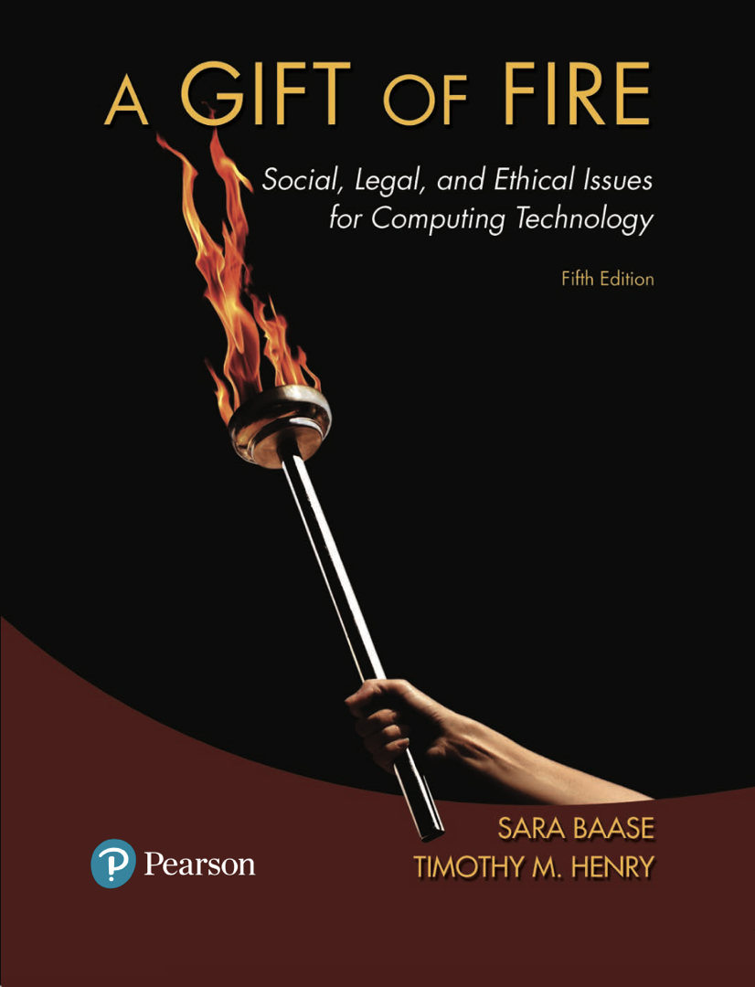
CMPS 310
Lecture 2
Chapter 1 Part 2:
Themes and Ethics
Based on slides prepared by Cyndi Chie, Sarah Frye and Sharon Gray.
Fifth edition updated by Timothy Henry
Copyright © 2018, 2013, 2008 Pearson Education, Inc. All Rights Reserved
Notes:
Socialbot – artificial intelligence program that simulates a human on social media
Going viral – something posted catches attention of people who view/copy/spread
Blog means web log
<number>

Slide 2
Overview
Change and Unexpected Developments
ecommerce
“free” applications
AI
Themes of Technology Change
Ethics
Deontology
Consequentialism
Positive and Negative rights
Social Contract Theory
Copyright © 2018, 2013, 2008 Pearson Education, Inc. All Rights Reserved
Notes:
Some benefits are obvious: Consumers can save time, money, and gasoline while researching products.
Some benefits are less obvious or were not obvious before they appeared: Auction sites give people access to customers they could not have found efficiently before. Lower overhead and ease of comparison shopping have brought down prices of many products. Small businesses and artists can sell directly to buyers, avoiding fees to middlemen and distributors. The Web has enabled a peer-to-peer economy.
<number>

Slide 3
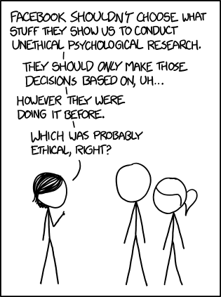

Slide 4

E-commerce
Amazon.com started in 1994 selling books on the Web. It has grown to be one of the most popular, reliable, and user-friendly commercial sites.
eBay.com facilitates online auctions.
Traditional brick-and-mortar business have established Web sites.
Online sales in the United States now total hundreds of billions of dollars a year.
Sellers can sell directly to buyers, resulting in a peer-to-peer economy.
Copyright © 2018, 2013, 2008 Pearson Education, Inc. All Rights Reserved
Notes:
Some benefits are obvious: Consumers can save time, money, and gasoline while researching products.
Some benefits are less obvious or were not obvious before they appeared: Auction sites give people access to customers they could not have found efficiently before. Lower overhead and ease of comparison shopping have brought down prices of many products. Small businesses and artists can sell directly to buyers, avoiding fees to middlemen and distributors. The Web has enabled a peer-to-peer economy.
<number>

Slide 5
E-commerce and trust concerns
People were reluctant to provide credit card information to make online purchases, so PayPal.com grew out of need for trusted intermediary to handle payments.
Encryption and secure servers made payments safer.
The Better Business Bureau established a Web site to help consumers see if others have complained about a business.
Copyright © 2018, 2013, 2008 Pearson Education, Inc. All Rights Reserved
Notes:
<number>

Slide 6
Free stuff
Advertising pays for many free sites and services, but not all.
Wikipedia funded through donations.
Businesses provide some services for good public relations and as a marketing tool.
Generosity and public service flourish on the Web. Many people share their expertise just because they want to.
Copyright © 2018, 2013, 2008 Pearson Education, Inc. All Rights Reserved
Notes:
Some free programs and services do not have all the features of the paid versions.
<number>

Slide 7
Free stuff
In order for companies to earn ad revenue to fund multimillion-dollar services, many free sites collect information about our online activities and sell it to advertisers.
Copyright © 2018, 2013, 2008 Pearson Education, Inc. All Rights Reserved
Notes:
This tracking is not always obvious; we consider it in Chapter 2.
<number>

Slide 8
Artificial intelligence
Turing Test: If the computer convinces the human subject that the computer is human, the computer is said to “pass”.
Lately there have been advertisements for “personal assistant” chat bots that can schedule appointments for you, etc.
How will it feel in the future when we can’t differentiate human and bot callers?
Copyright © 2018, 2013, 2008 Pearson Education, Inc. All Rights Reserved
Notes:
Philosopher John Searle argues that computers cannot be intelligent. They do not think; they manipulate symbols. They do so at a very high speed, and they can store, access, and manipulate a huge quantity of data, but they are not conscious. They do not understand; they simulate understanding.
Searle might say that although Watson won at Jeopardy!, Watson does not know it won.
<number>

Slide 9
Themes of Technology Challenges
Old Problem:New Context
Adapting to New Technology
Resistance from Established Interests
Non-cyber problems exist (crime/ads/etc.)
Violent Steam Content
New laws/policies/skills
FAA Drone Example
Business/Orgs/Unions will lose income or power!
French rideshare Law Example
Copyright © 2018, 2013, 2008 Pearson Education, Inc. All Rights Reserved
Notes:
FAA has a rule that all aircraft must carry a manual onboard. No exception for drones. Wouldn't the enemy love to have a manual!
France had a law that for Uber/LeCar drivers had to wait 15 minutes between customer hail and when they were let in the car!

Slide 10
Themes of Technology Challenges
Varied Sources of Solutions
Global Reach!
Tradeoffs/Controversy
More Technology
What is software theft?
Profound social, economic, political effects. Theft from across the world?
Wikileaks
Copyright © 2018, 2013, 2008 Pearson Education, Inc. All Rights Reserved
Notes:
FAA has a rule that all aircraft must carry a manual onboard. No exception for drones. Wouldn't the enemy love to have a manual!
France had a law that for Uber/LeCar drivers had to wait 15 minutes between customer hail and when they were let in the car!

Slide 11
Themes of Technology Challenges
Perfection is Direction, not option
Personal/Business/Law
There is no zero risk/zero side effect option
Criteria for choosing something from each is different
Copyright © 2018, 2013, 2008 Pearson Education, Inc. All Rights Reserved
Notes:
FAA has a rule that all aircraft must carry a manual onboard. No exception for drones. Wouldn't the enemy love to have a manual!
France had a law that for Uber/LeCar drivers had to wait 15 minutes between customer hail and when they were let in the car!

Slide 12
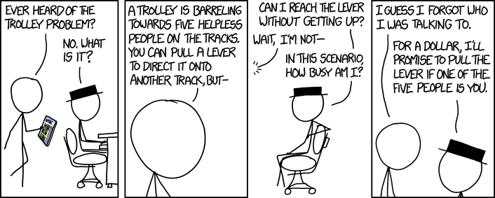

Slide 13

What is Ethics:
Study of what it means to “do the right thing”.
Assumes people are rational and make free choices.
Rules to follow in our interactions and our actions that affect others.
What does this mean for software engineers and researchers?
Copyright © 2018, 2013, 2008 Pearson Education, Inc. All Rights Reserved

Slide 14
A variety of ethical views:
Deontological theories (nonconsequentialist)
Absolute rules regardless of outcome
“Do Not Lie”
Immanuel Kant:
Universality: Rules apply to everyone
Logic/Reason: Logical behaviors are ethical, irrational is evil
People are not means to an end but an end themselves
The above form the “categorical imperative”
Copyright © 2018, 2013, 2008 Pearson Education, Inc. All Rights Reserved
Notes:
Deontological: Do not lie even if the result is good, like not telling an arsonist where someone lives.. Tough one.. Maybe say nothing?

Slide 15
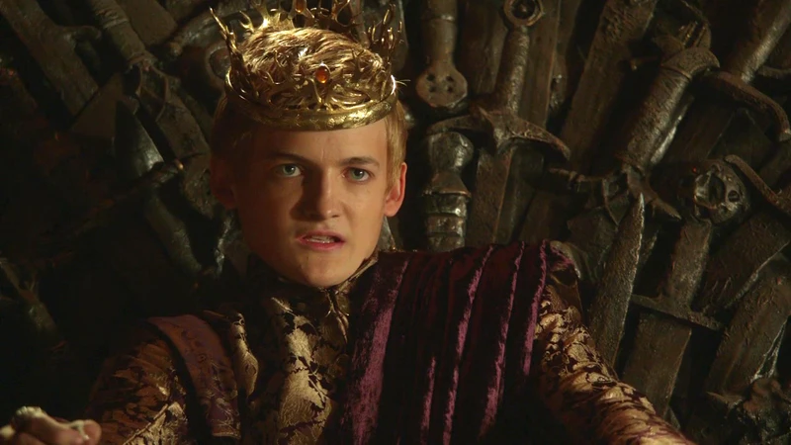
Evil King Dilemma
A deontologist is aware of a plan to assassinate an evil king. The king asks the deontologist if they know of a plan to assassinate him? How should the deontologist answer?`

Slide 16


Slide 17
Utilitarianism (consequentialist)
Mills argued that we should increase utility (happiness) to as many as possible
An action may increase utility for some while reducing for another
Does not respect individual rights
Can break a rule if it increases utility
Copyright © 2018, 2013, 2008 Pearson Education, Inc. All Rights Reserved
Notes:
Deontological: Do not lie even if the result is good, like not telling an arsonist where someone lives.. Tough one.. Maybe say nothing?

Slide 18
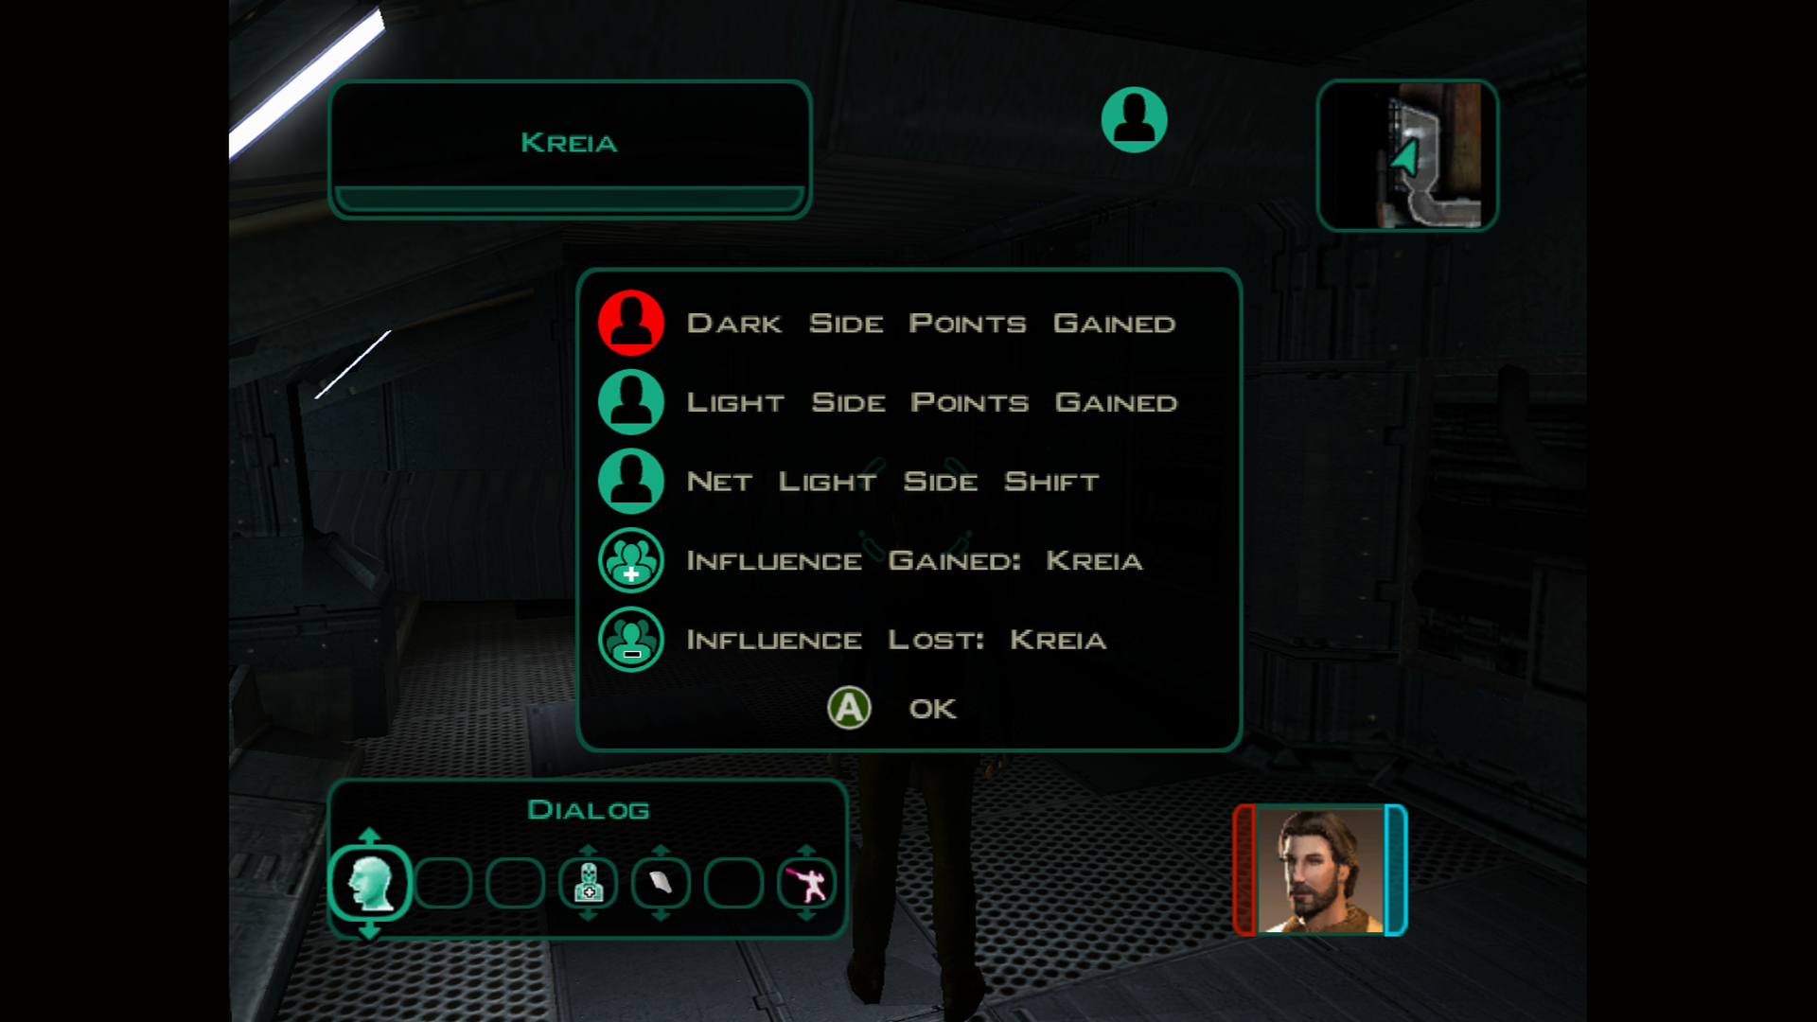
Net Good Gained

Slide 19

Death Weighing Dilemma
If there is a non-trivial possibility that a nuclear armageddon is coming, but we can avoid it by destroying a metropolitan capitol--do we destroy the capitol?

Slide 20
Natural Rights
People make their own decisions
Within a sphere of freedom
No interference even if others believe otherwise
Life, Liberty, Property Rights
private property allows for innovation
John Locke: Ourselves, our labor, and products of labor belong to us
Why would we create something if we were forced to give it up or it could be taken?
Copyright © 2018, 2013, 2008 Pearson Education, Inc. All Rights Reserved

Slide 21
Negative rights (liberties)
The right to act without interference.
I can’t be arrested for my religious beliefs.
Positive rights (claim-rights)
An obligation of some people to provide certain things for others
If owning property is a right, then programs to house the homeless must be in place
Copyright © 2018, 2013, 2008 Pearson Education, Inc. All Rights Reserved

Slide 22
Golden rules
Treat others as you would want them to treat you.
This is an important principle in many religions.
Contributing to society
Doing one’s work honestly, responsibly, creatively, and well is virtuous.
Copyright © 2018, 2013, 2008 Pearson Education, Inc. All Rights Reserved

Slide 23
Social contracts and a theory of political justice
Thomas Hobbes posed that people willingly submit to a common law in order to live in a civil society.
We don’t like speeding tickets, but we abide by traffic laws in order to maintain safety on roads.
Social contract theory judges how well we’re doing by how well our least fortunate members of society are doing. Different than utilitarian’s aggregate view.
This take on social contract theory was developed by John Rawls who based a view of justice as fairness.
Copyright © 2018, 2013, 2008 Pearson Education, Inc. All Rights Reserved
Notes:
Thomas Hobbes developed ideas of social contract theory in his book Leviathan (1651).
Philosopher John Rawls took social contract theory further, developing provisions of the “contract” based on his view of justice as fairness.
<number>

Slide 24
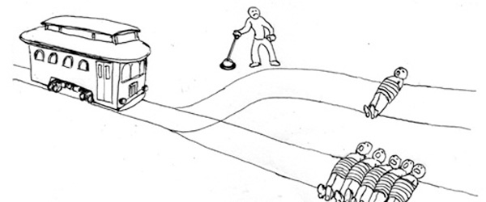
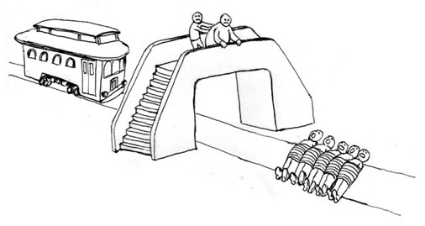
A variety of ethical views:
No simple answers
Copyright © 2018, 2013, 2008 Pearson Education, Inc. All Rights Reserved
Notes:
Ethical theories do not provide clear, incontrovertibly correct positions on most issues. We can use the approaches we described to support opposite sides of many an issue.
<number>

Slide 25
Some important distinctions:
Right, wrong, and okay
Distinguishing wrong and harm
Separating goals from constraints
Personal preference and ethics
Law and ethics
Copyright © 2018, 2013, 2008 Pearson Education, Inc. All Rights Reserved
Notes:
We can think of acts as either ethically obligatory, ethically prohibited, or ethically acceptable.
Harm alone is not a sufficient criterion to determine that an act is unethical.
The ethical character of a company depends on whether the actions taken to achieve the goal are consistent with ethical constraints.
It can be difficult to draw a line between what we consider ethically right or wrong and what we personally approve or disapprove of.
Ethics precedes law in the sense that ethical principles help determine whether or not we should pass specific laws. A good law will set minimal standards that can apply to all situations, leaving a large range of voluntary choices. Ethics fills the gap between general legal standards that apply to all cases and the particular choices made in a specific case.
<number>

Slide 26
Homework
Anser these questions in a word document and submit it on Moodle by next Monday at 9 AM.
How will we react when we can go into a hospital for surgery performed entirely by a machine? Is there a point where it will be acceptable to accept machine surgeons over human ones? How about machine police?
How will we react when we can have a conversation and not know if we are conversing with a human or a machine? How would you feel if my email replies were mostly generated by an AI? Do we have a right to know whether we are conversing with a chat bot?
Copyright © 2018, 2013, 2008 Pearson Education, Inc. All Rights Reserved

Slide 27
How will we react when chips implanted in our brains enhance our memory with gigabytes of data and a search engine? What would be the implication of replicating our cognition for others?
Look up Hegelian Dialectics (just the first few paragraphs of https://plato.stanford.edu/entries/hegel-dialectics/). How can a dialectic approach to ethics help? Can a dialectic approach help resolve the tensions between different strains of thought, i.e. deontology vs utilitarianism?
Which of a deontologist or consequentialist approach better explains why I shouldn’t drive on the right side of the road in the United Kingdom?

